Slide 1
Brazilian E-Commerce Data Analyze
OLIST Company
UK-GENERATION DA-LON2/Final Project
GROUP 04
Hamid, Kit, Shayanny Martino , Sherifat Odu Stephen
October 11, 2022

Slide 2
Agenda
01. Introduction
02.Dataset
03. Analytics Insights
04.
05. Conclusion
Notes:
1- We need maybe add information about dataset / 2- What we cleaned and how .

Slide 3

Introduction
The Olist company , is an e-commerce company from Brazil, started their operations in 2015. Following their mission - empower digital retail and provide real growth opportunities for small, medium and large businesses
E-commerce challenges considering for Olist consulting
Get high reputation in the marketplaces
Product catalogue creation
Product pricing
Logistics and transport services
Operational management

Slide 4
Dataset
100k orders from 2016 through 2018 placed by customers on Olist from multiple marketplaces in Brazil.
9 Flat CSV File, containing information about order status, payment and freight performance, customer location, product attributes and reviews written by customers.
To clean the database was used MySQL , Python and Power BI – Power Querying
.

Slide 5
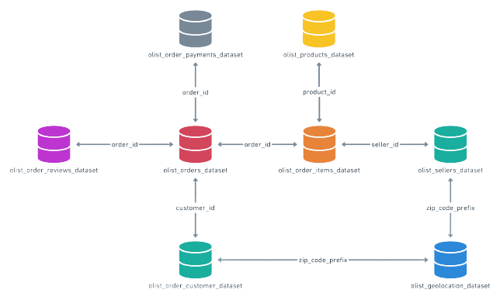
DataSet Schema
Key Words
Order Id
Product Id
Seller Id
Customer Id
Zip Code prefix
Notes:
To add PowerBI schema

Slide 6

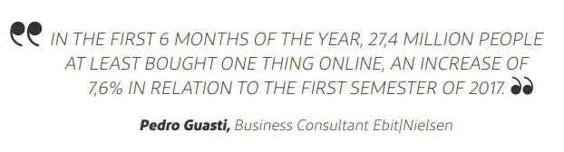
E-commerce Brazil
Insights from Web shoppers 360 Overwier 2018 : https://company.ebit.com.br/webshoppers/webshoppersfree
The first semester of 2018 also registered a change in the type of payment of online purchases: in the first semester of 2017, 48,2% of the sales in e-commerce were paid in cash. In the same period of 2018, 52,1% decided to pay their purchases in an only instillment, also taking profit of incentives of shops with discounts.
The model, a booming one proved to be equally advantageous to new formal and informal sellers of new or used products. This way, not necessarily the sellers need efforts and investment to structure his/her own commerce with higher scalability.

Slide 7
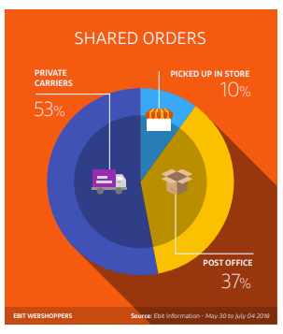
E-commerce Brazil
Insights from Web shoppers 360 Overwier 2018 : https://company.ebit.com.br/webshoppers/webshoppersfree
The highest level of satisfaction (87,4% for handing and sending of products”) with the service of delivery from e-commerce sites, regard the orders that were picked up in the shops and other collection points. The highest level of dissatisfaction refers to the services by the Post Office ,reached a percentage of 16,6% of dissatisfied people.

Slide 8
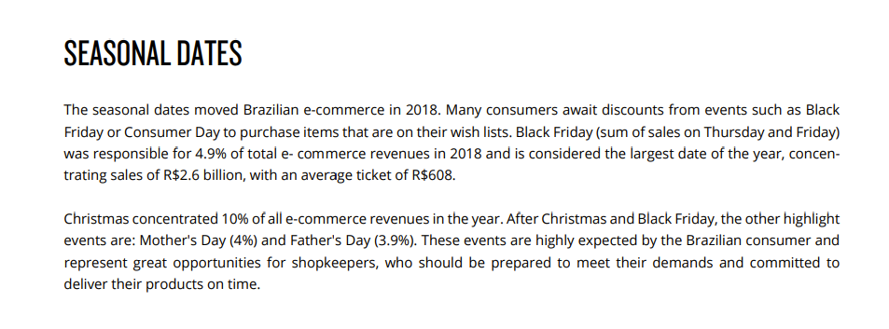
E-commerce Brazil
Insights from Web shoppers 360 Overwier 2018 : https://company.ebit.com.br/webshoppers/webshoppersfree

Slide 9

Analyse
WHERE ARE THE GAPS
WHERE ARE THE POTENTIALS
Olist Code of Ethics.
* Relation with the customers
* Relationship with Supplier
* Sustainability
Ebit webshoppers overview
Notes:
Import Dashboard from PowerBI Service ( It is possible to import by page/ by charts) wherever

Slide 10
Insights After to Check The Dataset Table
Customer
Seller insights
Operation Insights
Understanding Customer Demographic
Shopping behavior and category product preferences- to make target marketing strategy
Customer lifetime values
Payment Behaviors
Number of customer by hierarchy date
Understanding seller’s demographic
Understand sales performance and product rank
Identify Top Sellers and Seller by Score Review
Top Product Categories (with highest growth)
Oversea logistics-performances and delivery time
Monitor frequently delivery rate (review scores)
Check the order Status
Financials
Analyse revenue growth and sales performance .
Market-Share and Average Ticket

Slide 11
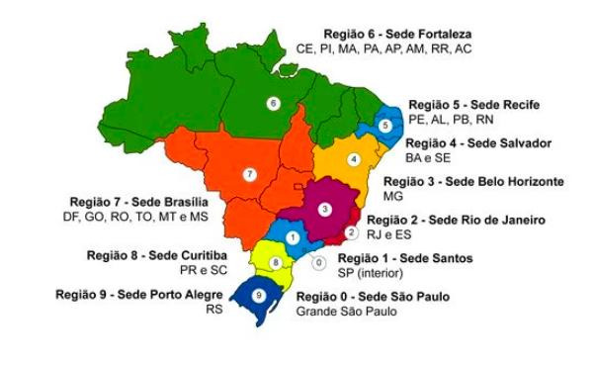
Brazilian Regions
Map of Brazil's Zip Code Regions
Organized by Federation, using as a parameter the socio-economic development and demographic growth factors.
source: https://www.correios.com.br/acesso-a-informacao/dados-abertos

Slide 12
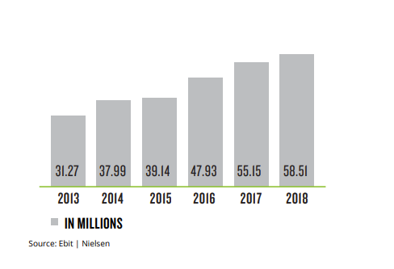
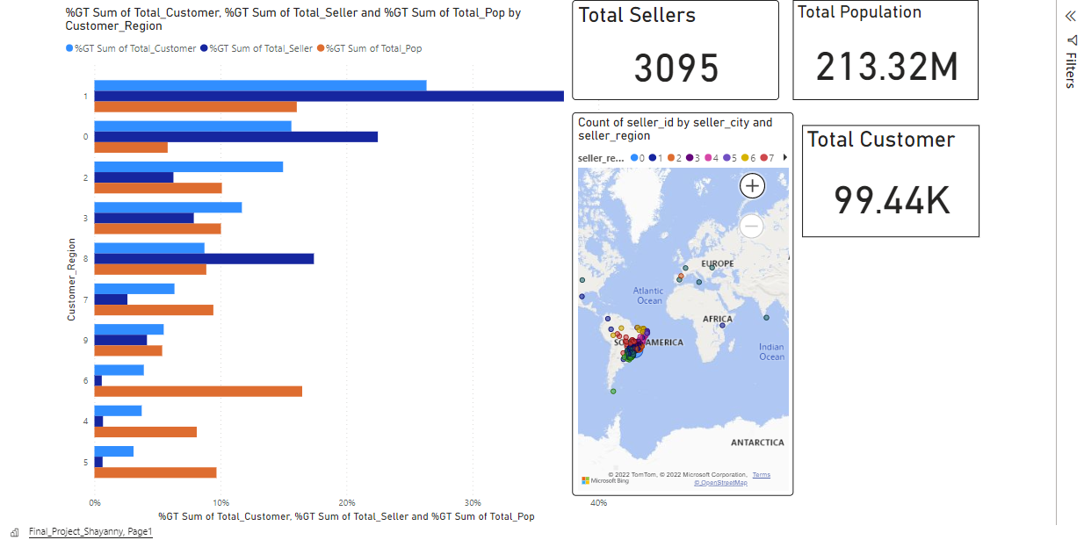
Demographic Analysis

Slide 13
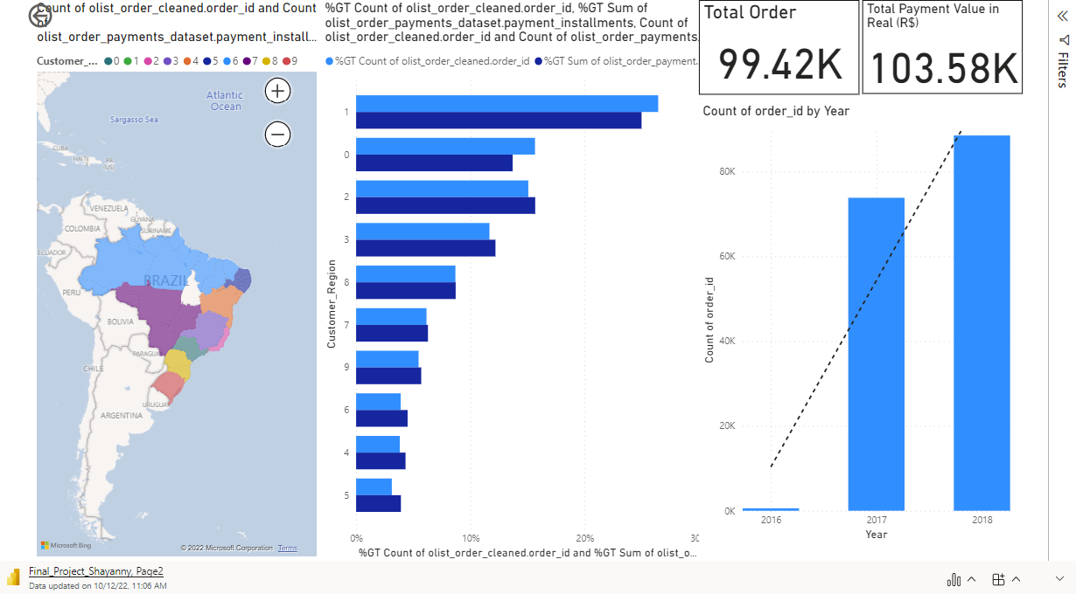

Slide 14
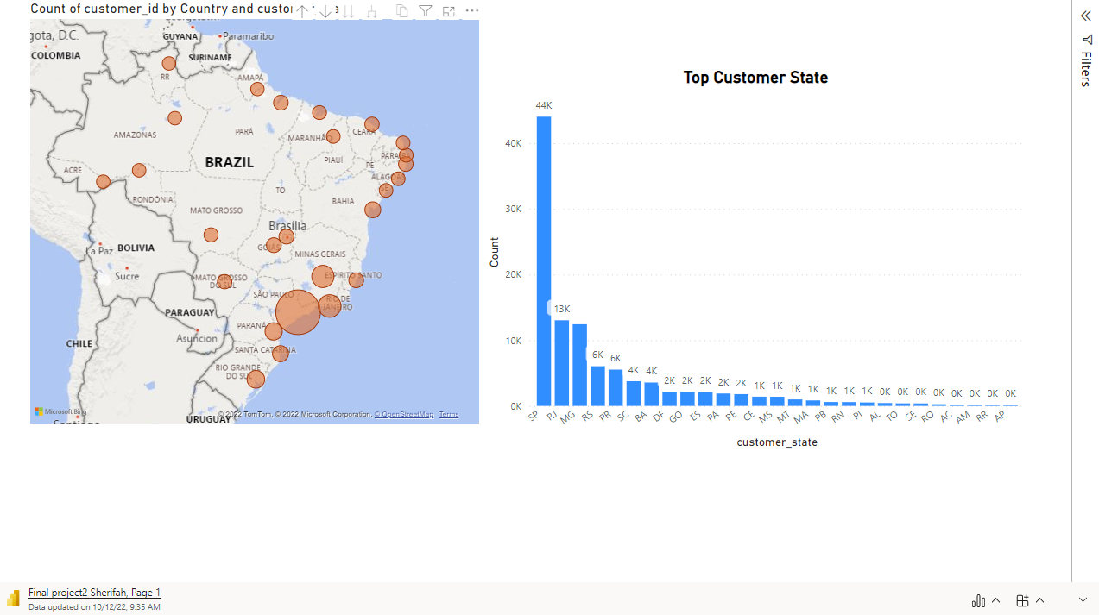

Slide 15
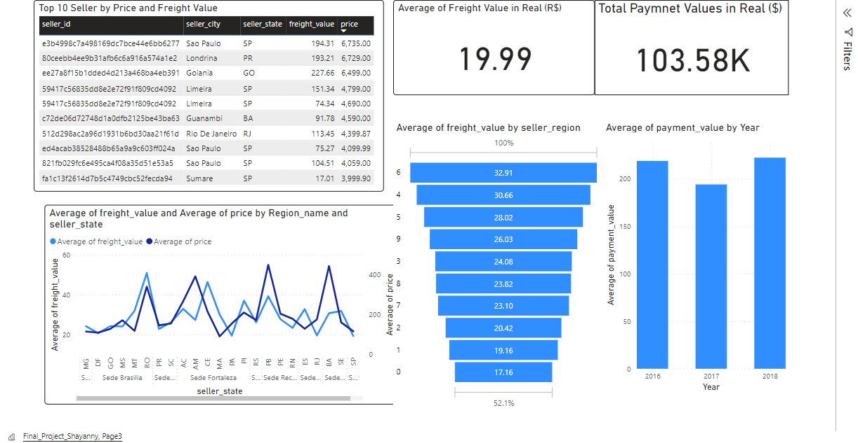
Financial and Operational Analysis

Slide 16
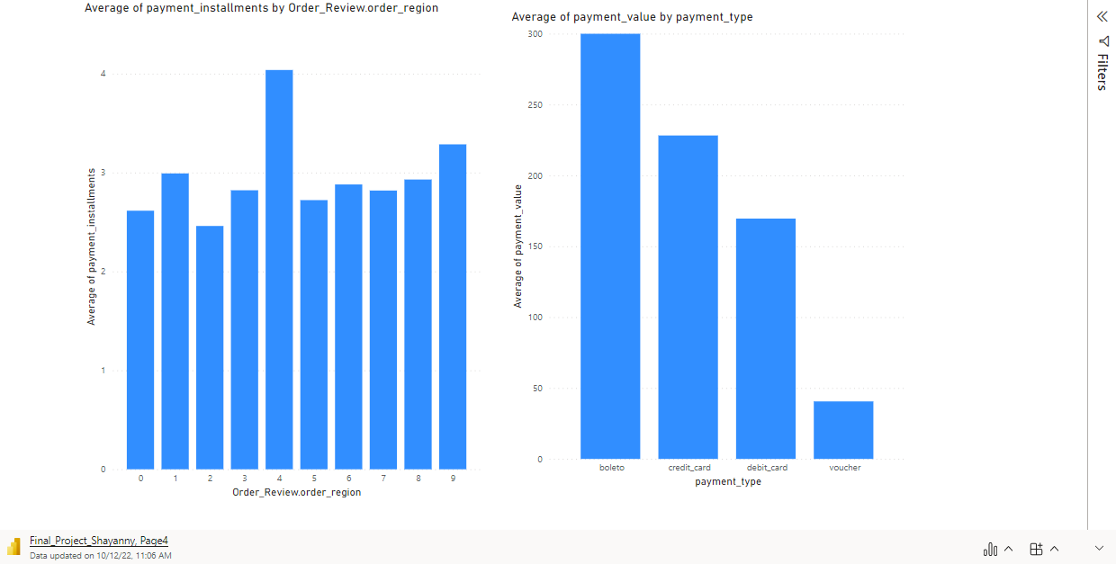

Slide 17
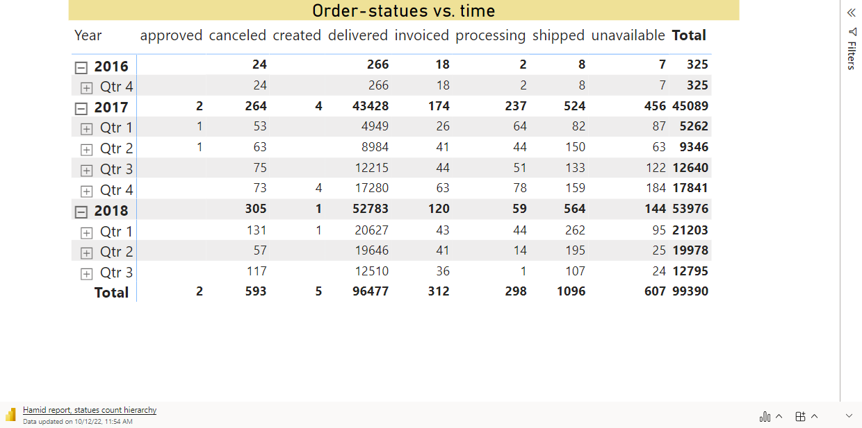

Slide 18
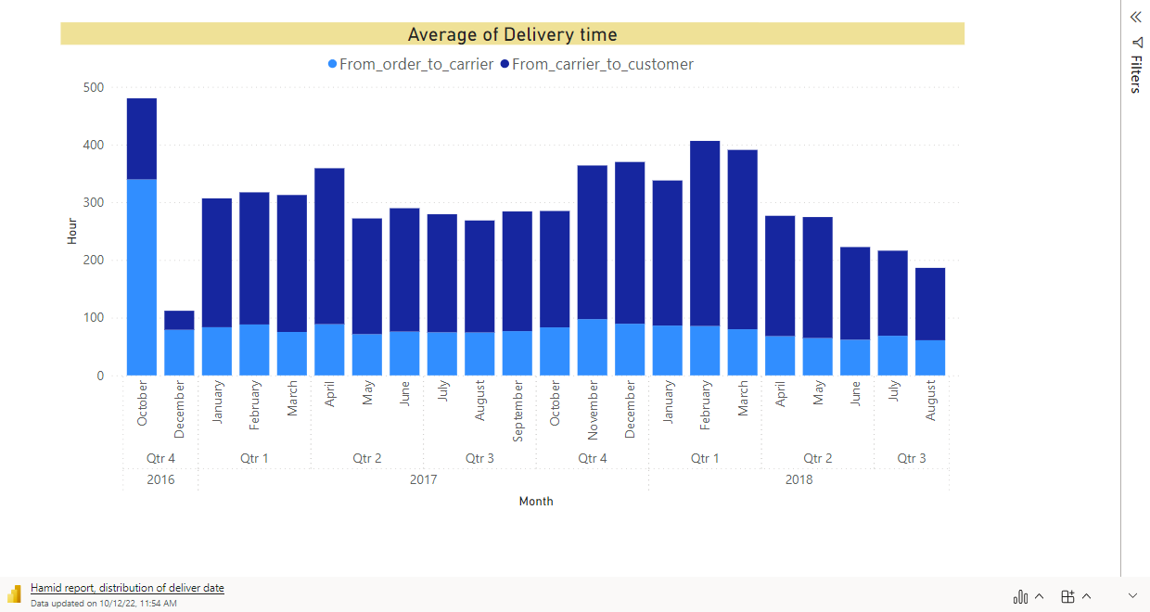

Slide 19
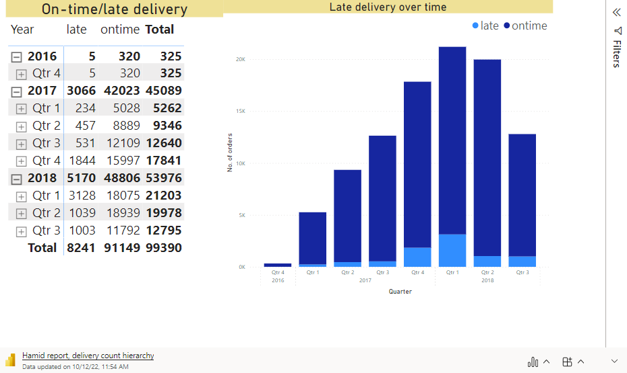

Slide 20
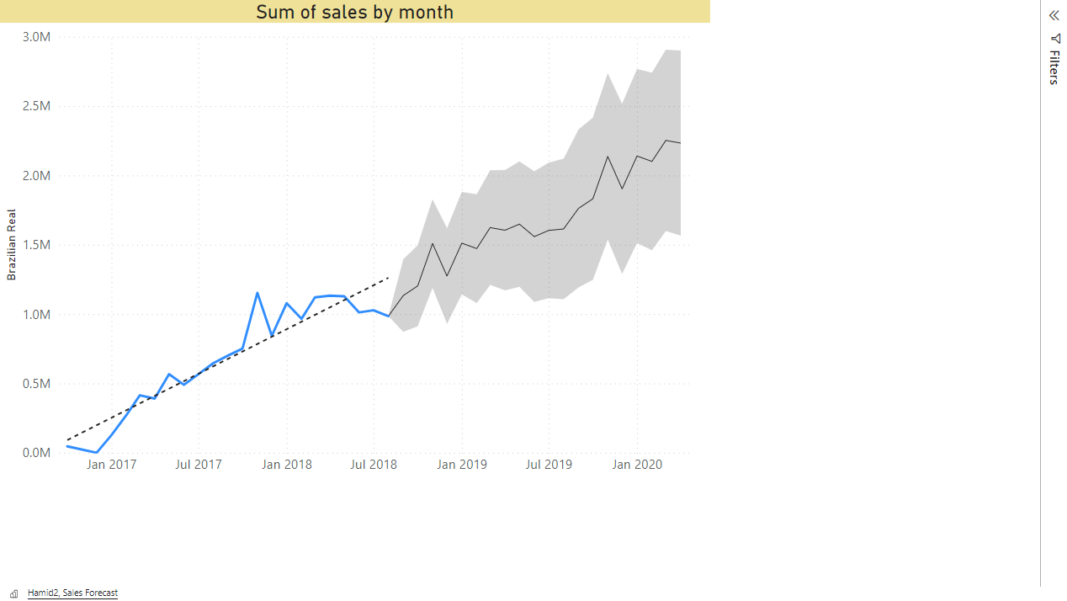

Slide 21
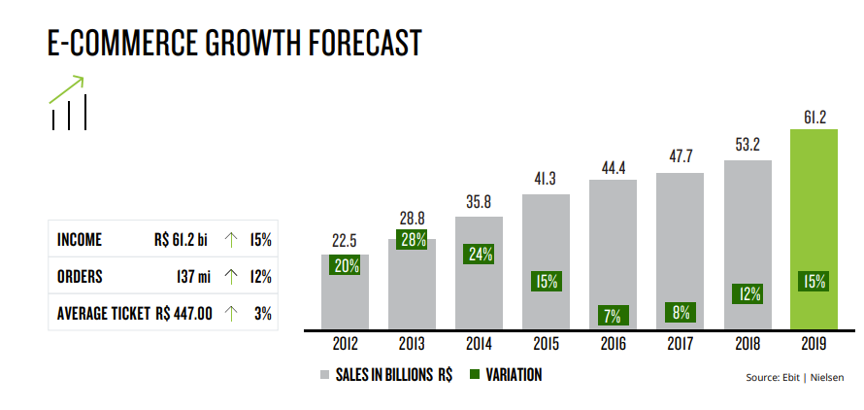
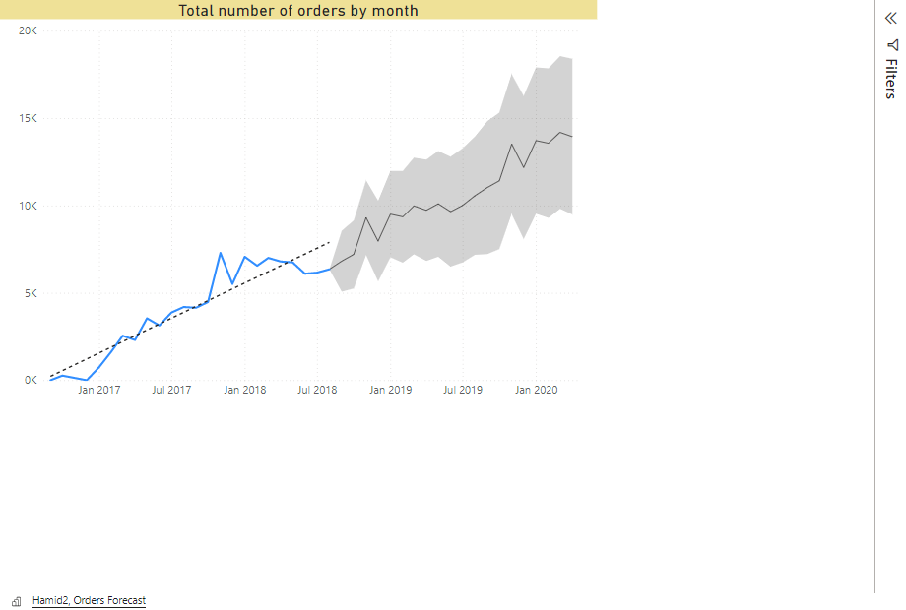
Olist Data
E-bit – Webshoppers Data

Slide 22
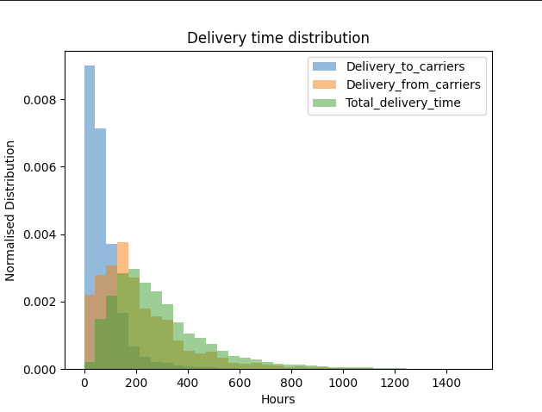
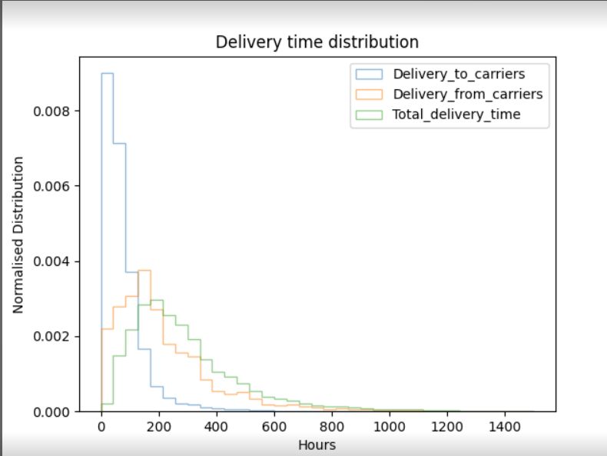

Slide 23
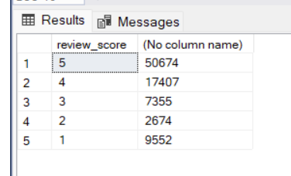
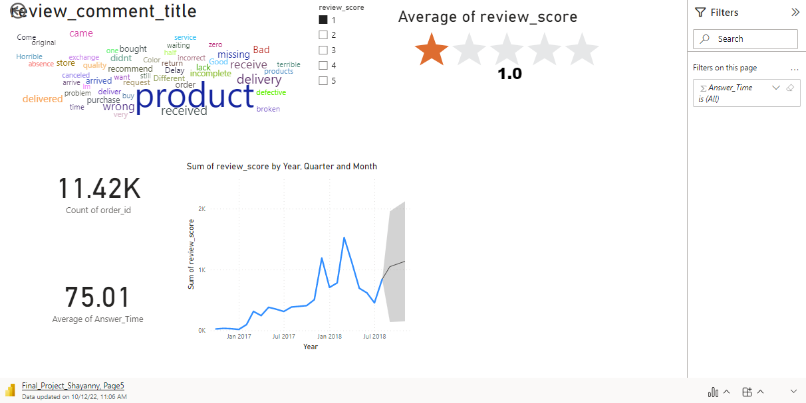
Costumer Behavior Analysis
Orders Without comments

Slide 24
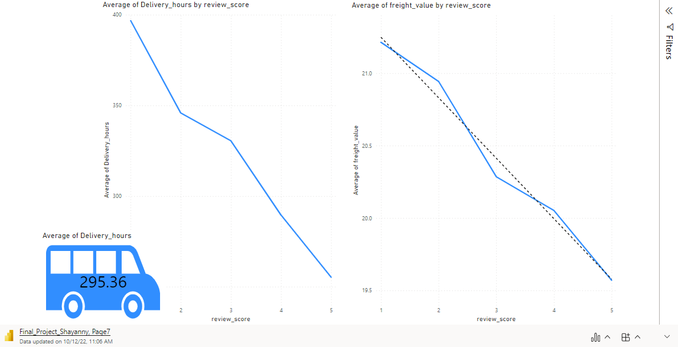
Delivery Time and Freight Value Have Impact on Score Review

Slide 25
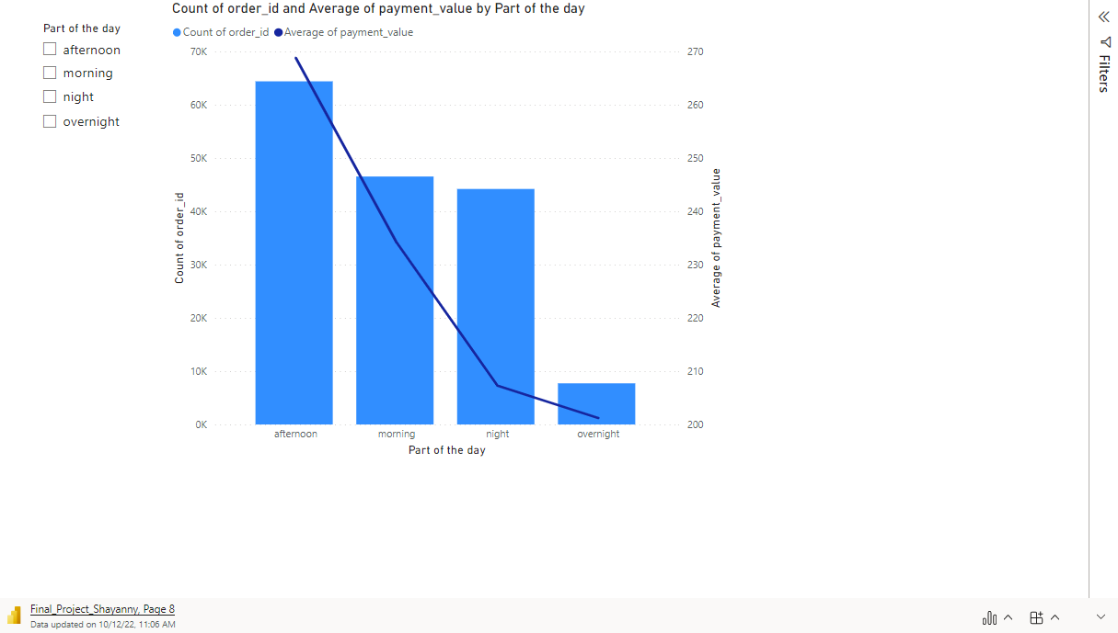

Slide 26
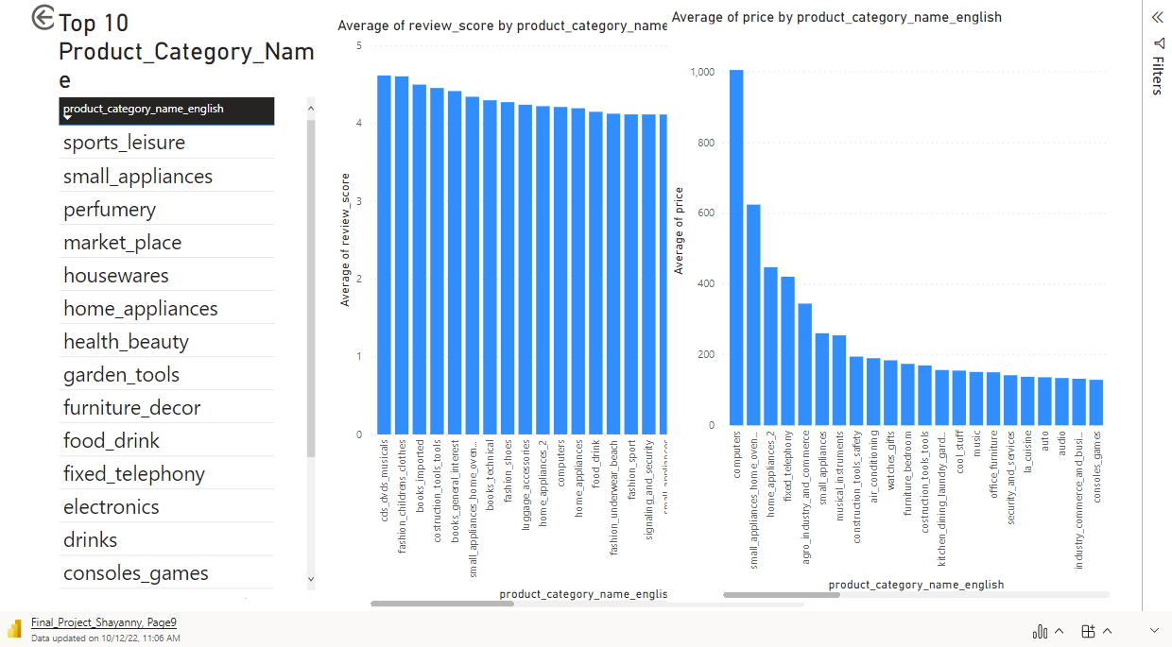

Slide 27
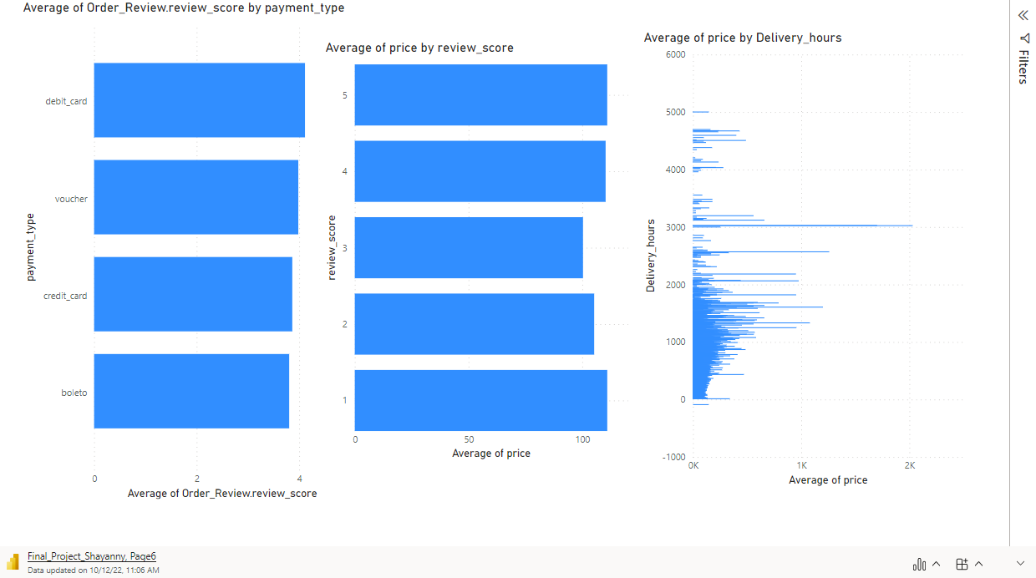

Slide 28
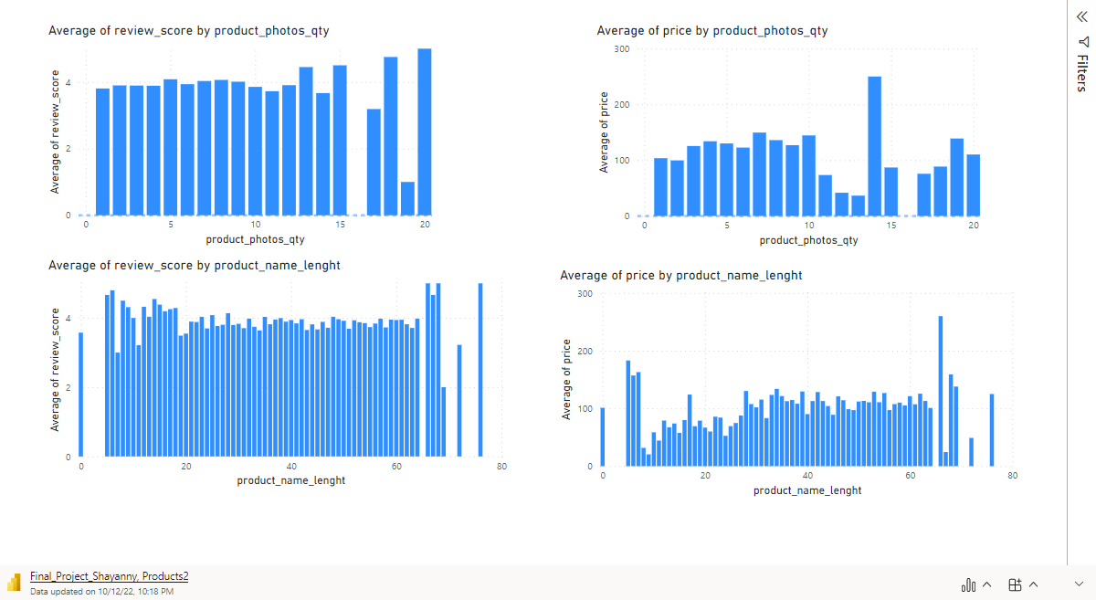

Slide 29
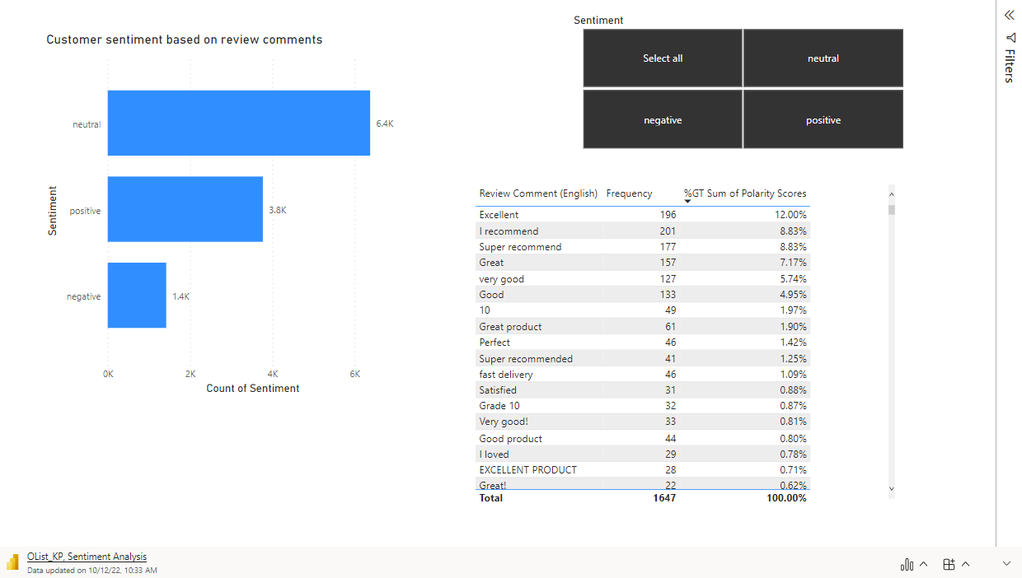
Sentiment Analysis

Slide 30
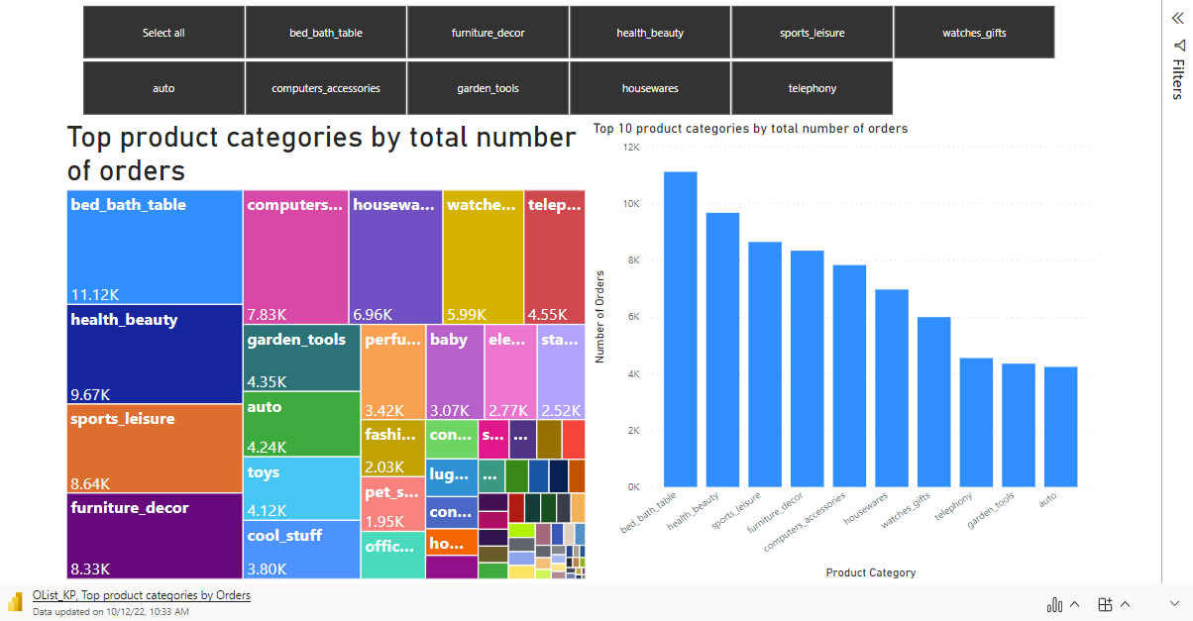
Top Product Categories

Slide 31
Recommendations
Relation with Customers
Relation with Operations
Investigate the regions 5,4 and 6 – To engage more sellers.
Define a Target to engage more costumers in regions 8, 1 and 0. Increase Market-Share
Increase customer satisfaction at least 2% / Increased 2% 2017 - 2018
Maintain growth
Surveys to extract more details about reviews (Cluster by product or delivery service)
Advertising and Marketing during the night, overnight and morning.
Offers and options for region 4 about payment installments
Investigate the bad reviews without comments . Engage this relation – Post Purchase Service/ Customer Service Team.
Delivery time had a proven effect on bad reviews.
Delivery time distribution shows a lot of late delivery. It makes some improvement, but it’s much higher than E-Commerce norms. Average delivery time for sellers is about 4 days, and it should reduce to 1-2 days.
Average delivery time by carriers is very high with an average of 8 days. Although Brazil is a very big country, but the Olist must find a quicker way to send the items to its customers.
Relation With Suppliers
Investment in the Top 10 categories according Preference and Average Price.
Produce a better Categories Catalogue following the Trends
Open new categories relation to sustainability

Slide 32

Thank you !
Any Question ?

